Slide 1
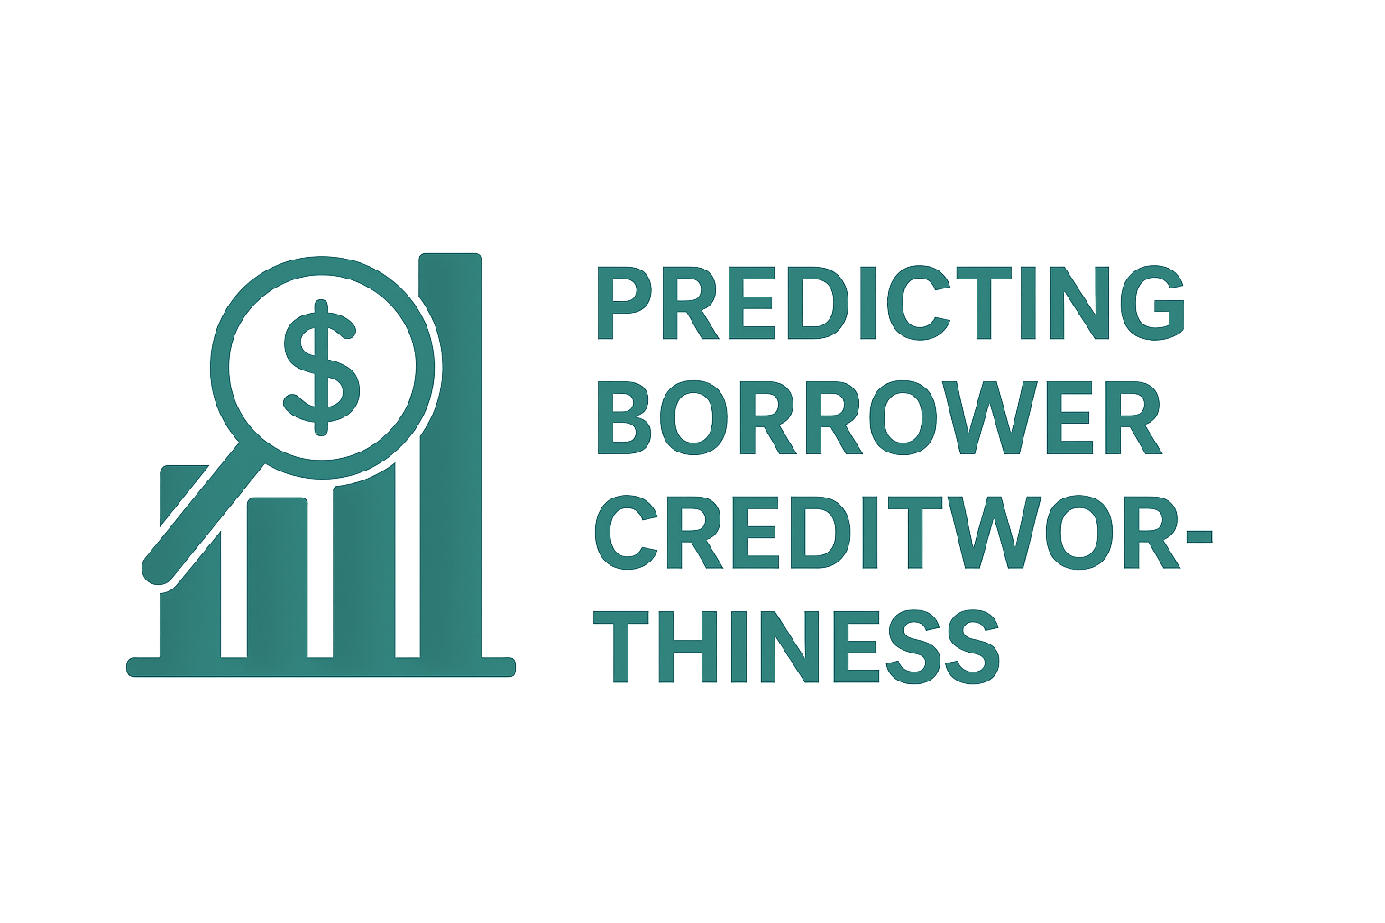
Predicting Borrower Creditworthiness Using ML
Data Analysis and Machine Learning for Finance
Tang Seong Fatt| 27/06/2025
Notes:
Good \[morning/afternoon], and thank you for the opportunity to present. I'm here to walk you through our loan default risk analysis and key findings

Slide 2
Content
Project Objective
Dataset Overview
Data Preparation
Model Training & Evaluation
Feature Importance
Key Insights
Conclusion & Recommendations
Deliverables

Slide 3
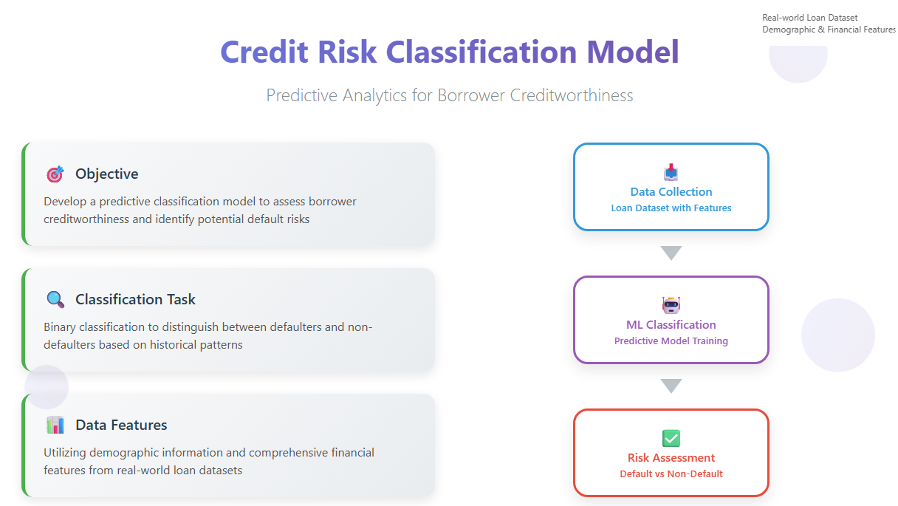
Project Objective
Develop a predictive classification model to assess borrower creditworthiness
Identifying defaulters vs. non-defaulters
Using demographic and financial features from a real-world loan dataset.
Notes:
1. Objective
"Our goal was to identify factors contributing to loan default and evaluate a machine learning model that could help in early risk detection."

Slide 4
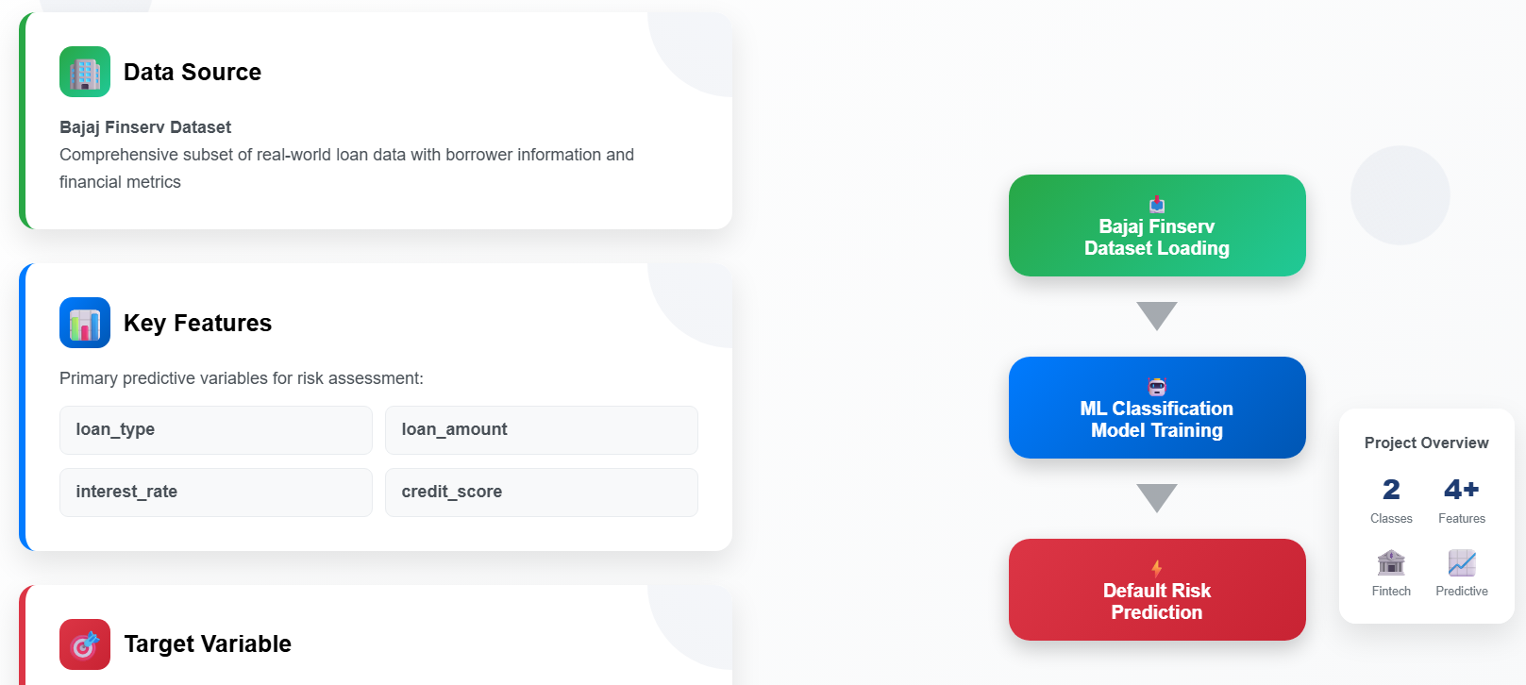
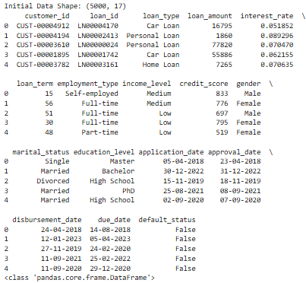
Dataset Overview
Source: Subset of Bajaj Finserv data.
Features: loan_type, loan_amount, interest_rate, credit_score, etc.
Target: default_status (binary classification).
Notes:
2. Data Overview
"We worked with data that included credit scores, income levels, interest rates, loan amounts, employment types, and default status. One important observation: the dataset is imbalanced — most loans were repaid, and only a smaller portion resulted in default."

Slide 5
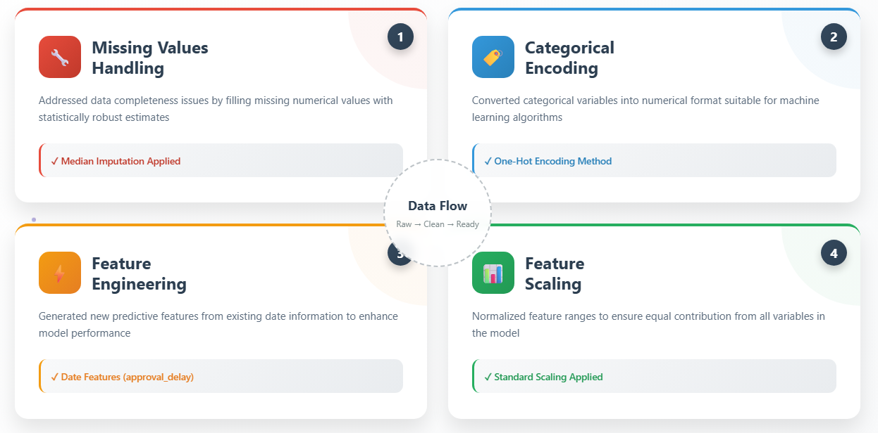
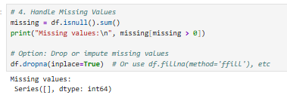
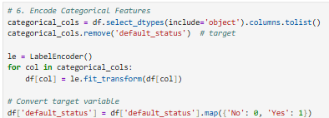
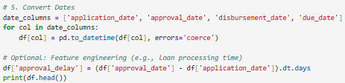
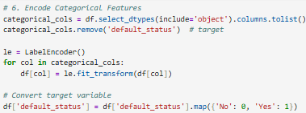
Data Preparation
Handled missing values using median imputation.
Encoded categorical features using one-hot encoding.
Created features from dates (e.g., approval_delay).
Applied standard scaling.
Notes:
2. Data Overview
"We worked with data that included credit scores, income levels, interest rates, loan amounts, employment types, and default status. One important observation: the dataset is imbalanced — most loans were repaid, and only a smaller portion resulted in default."

Slide 6
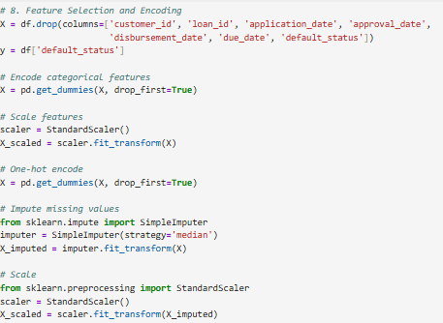
Data Preparation
Handled missing values using median imputation.
Encoded categorical features using one-hot encoding.
Created features from dates (e.g., approval_delay).
Applied standard scaling.
Notes:
2. Data Overview
"We worked with data that included credit scores, income levels, interest rates, loan amounts, employment types, and default status. One important observation: the dataset is imbalanced — most loans were repaid, and only a smaller portion resulted in default."

Slide 7
Model Training & Evaluation
Models Used: Logistic Regression, Random Forest, XGBoost
Metrics Evaluated: Precision, Recall, F1-score, Accuracy, ROC AUC
Train-Test Split: 70% train, 30% test
Model | Accuracy | ROC AUC | Precision (False) | Recall (False) | F1-score (False) | Precision (True) | Recall (True) | F1-score (True)
Logistic Regression | 0.80 | 0.49 | 0.80 | 1.00 | 0.89 | 0.00 | 0.00 | 0.00
Random Forest | 0.80 | 0.48 | 0.80 | 1.00 | 0.89 | 0.00 | 0.00 | 0.00
XGBoost | 0.77 | 0.50 | 0.80 | 0.95 | 0.87 | 0.22 | 0.05 | 0.08
Notes:
3. Key Findings
"From our analysis, we found that low credit scores, high interest rates, lower income levels, and certain employment types are strongly associated with a higher risk of default. This suggests a clear profile of higher-risk borrowers.“
Logistic Regression and Random Forest models perfectly recall non-defaulters but fail to detect defaulters.
XGBoost shows slight improvement in precision for defaulters but recall remains very low.
ROC AUC scores are near 0.5, indicating models perform only marginally better than random guessing.
Future work: Explore class imbalance handling (e.g., SMOTE), feature engineering, and hyperparameter tuning to improve predictive power.

Slide 8
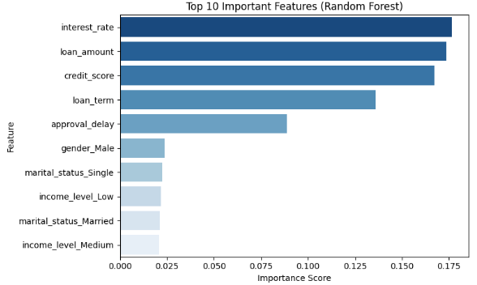
Feature Importance
Top predictors: credit_score, interest_rate, loan_amount.
Feature importances extracted from Random Forest.
Notes:
4. Data Challenge
"Because default cases are a minority, class imbalance was a challenge. We noted this and recommend using resampling techniques like SMOTE or class weighting to improve model learning.“
SMOTE: Synthetic Minority Oversampling Technique

Slide 9
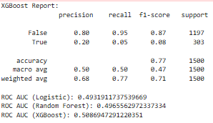
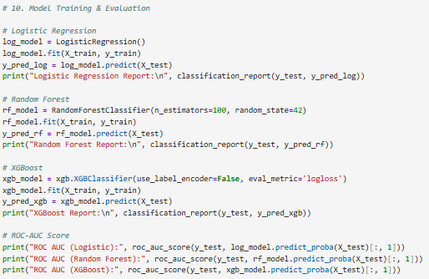
Key Insights
XGBoost performed the best. It was able to identify high-risk borrowers with relatively strong precision and recall
Low credit score and high interest rate increase default risk.
Employment type and income level also contribute.
Default rate is imbalanced; majority of loans are repaid.
Notes:
5. Model Insights
"We trained several models, and XGBoost performed the best. It was able to identify high-risk borrowers with relatively strong precision and recall. However, there's still room for improvement through feature refinement and better handling of the imbalance."
6. Visual Insights
"We visualized distributions across income levels and employment types, showing how these influence default risk. For example, lower income categories had a noticeably higher default rate."

Slide 10
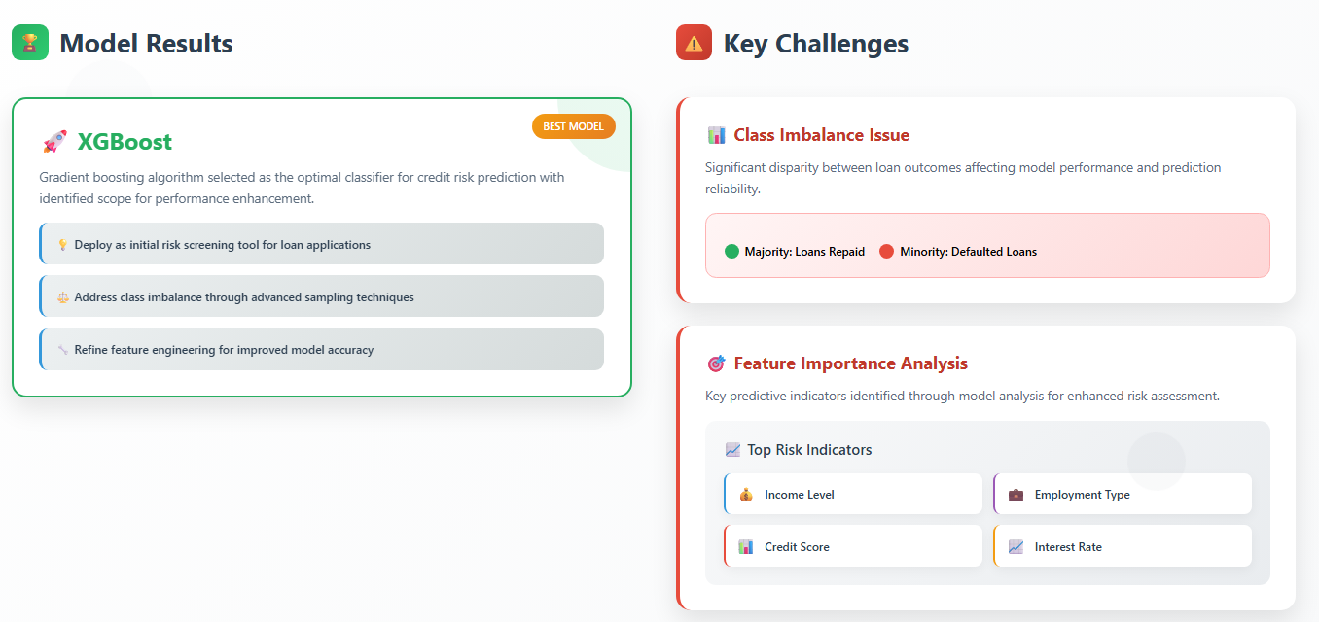
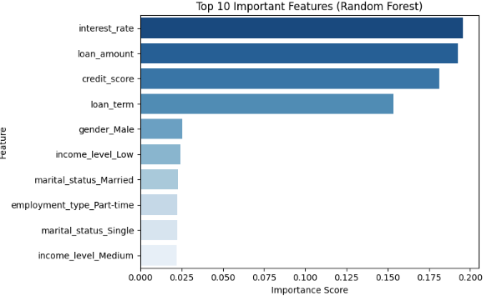
Conclusion & Recommendations
Best model: XGBoost (with scope for improvement).
Use model as initial risk screening tool.
Address class imbalance and refine features for better accuracy.
Challenges
Class imbalance: Majority of loans are repaid, minority defaulted.
Feature importance shows income level, employment type, credit score, and interest rate as key indicators.
Notes:
7. Recommendations
"We suggest using the model as a screening tool to flag high-risk applicants early in the loan application process. With further tuning and regular retraining, this tool can support smarter lending decisions."
8. Conclusion
"To sum up, our analysis offers both business insights and a working model. While it’s not perfect, it provides a strong foundation for more accurate and proactive risk management."

Slide 11
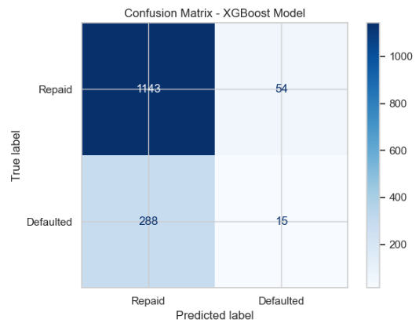
Conclusion & Recommendations
Notes:
8. Conclusion
"To sum up, our analysis offers both business insights and a working model. While it’s not perfect, it provides a strong foundation for more accurate and proactive risk management."

Slide 12
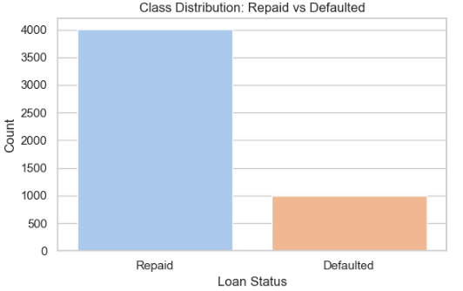
Conclusion & Recommendations
Class imbalance: Majority of loans are repaid, minority defaulted
Notes:
7. Recommendations
"We suggest using the model as a screening tool to flag high-risk applicants early in the loan application process. With further tuning and regular retraining, this tool can support smarter lending decisions."
8. Conclusion
"To sum up, our analysis offers both business insights and a working model. While it’s not perfect, it provides a strong foundation for more accurate and proactive risk management."

Slide 13
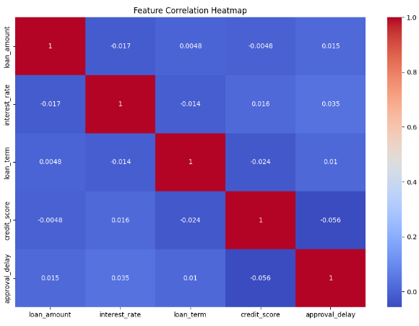
Conclusion & Recommendations
Notes:
7. Recommendations
"We suggest using the model as a screening tool to flag high-risk applicants early in the loan application process. With further tuning and regular retraining, this tool can support smarter lending decisions."
8. Conclusion
"To sum up, our analysis offers both business insights and a working model. While it’s not perfect, it provides a strong foundation for more accurate and proactive risk management."

Slide 14
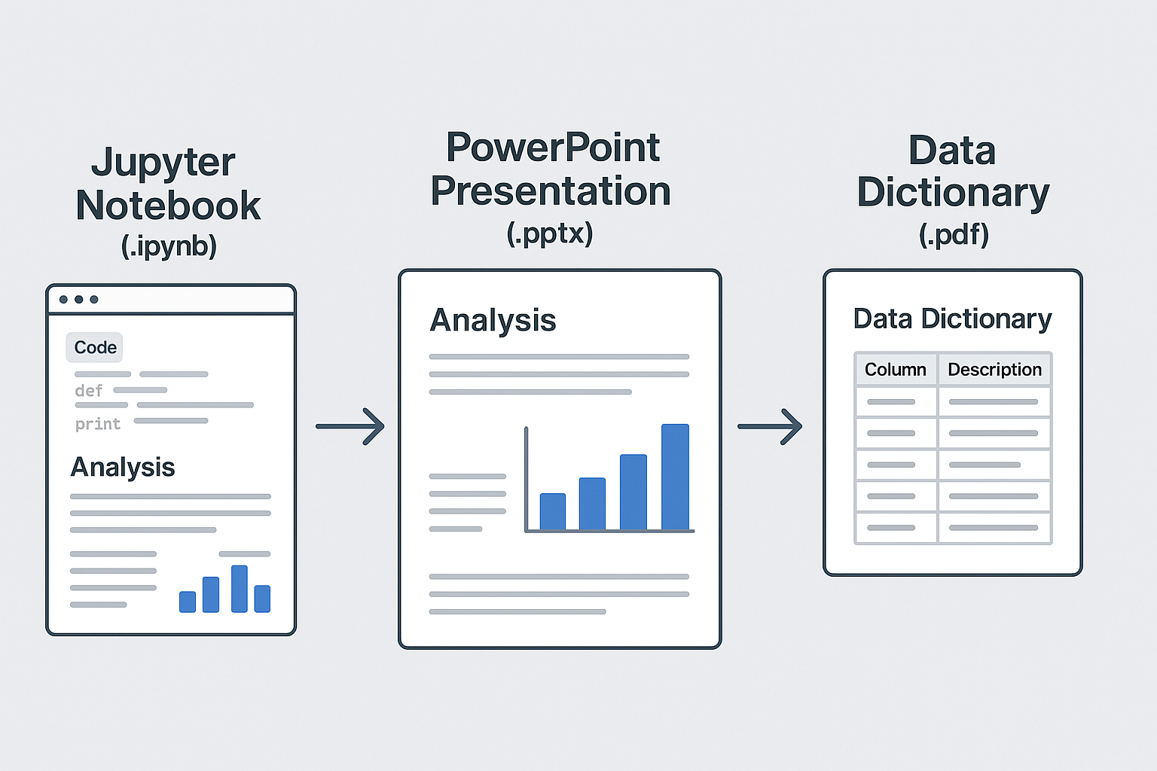
Deliverables

Slide 15
Q&A
Thank you for your attention!
Open to any questions or feedback.

Slide 16
Jupyter code
Thank you

Slide 17
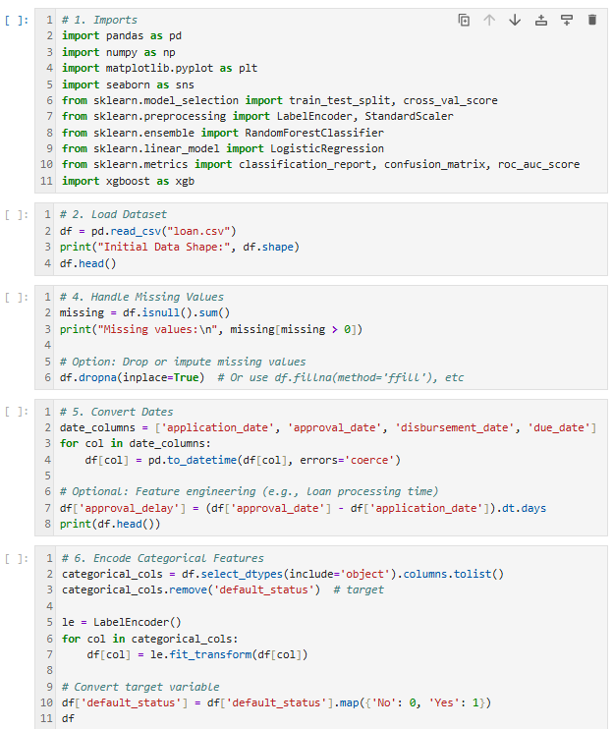

Slide 18
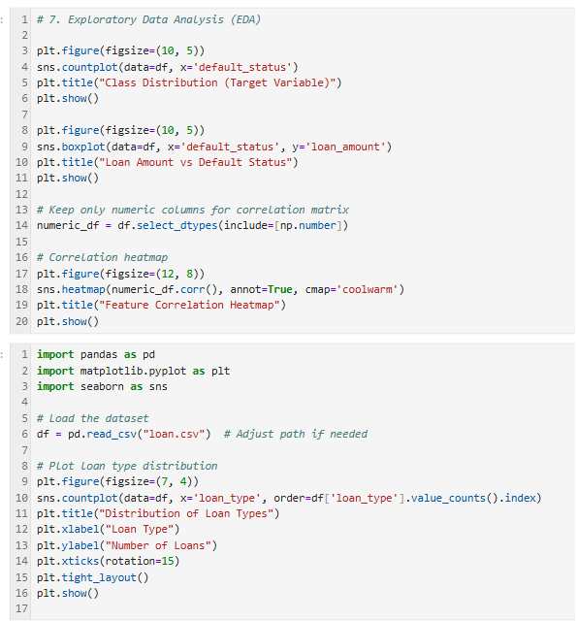

Slide 19
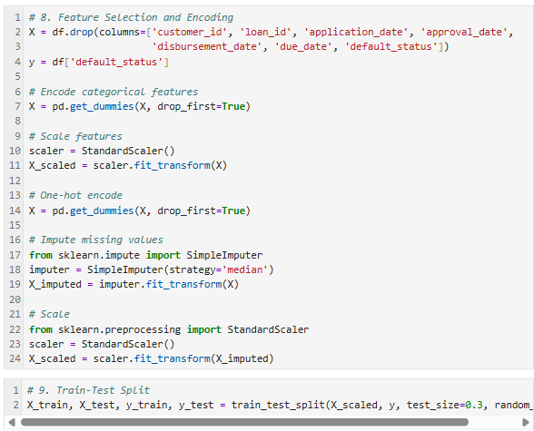

Slide 20
